Slide 1
Employee Data Analysis using Excel
STUDENT NO: THRISHA.B
REGISTER NO: 312210077
DEPARTMENT:BCOM GENERAL
COLLEGE :VALLIAMMAL COLLEGE FOR WOMEN

Slide 2
PROJECT TITLE
Employee sales Analysis using Excel

Slide 3


AGENDA
Problem Statement
Project Overview
End Users
Our Solution and Proposition
Dataset Description
Modelling Approach
Results and Discussion
Conclusion
3/21/2024 Annual Review

Slide 4

PROBLEM STATEMENT It provides an effective framework to explain the problem your organization wants to solve. In this presentation , we can easily identify the amount of sales done by each employee in an organization on the daily basis.

Slide 5

PROJECT OVERVIEW
Analyze the sales performance of employee to identify trends, strengths, and weaknesses.
Identity factors that influence sale performance.
Develop recommendations to improve sales performance and increase revenue.
It also helps to determines Key Performance Indicator.
The data helps to understand employee motivation level and develop initiatives to increase job satisfaction and retention

Slide 6

WHO ARE THE END USERS? The end users 0f employee sales analysis are: 1. Sales managers 2. Sales team 3. Human resources 4. Training and development 5. IT and data analytics team 6. External stakeholders.

Slide 7

OUR SOLUTION AND ITS VALUE PROPOSITION Filtering – remove missing values. Conditional formatting - blanks ,highlight , background. Formula - perform arithmetical operation. Pie chart - depicts the overall view point.

Slide 8
Dataset Description 1. Employee ID - unique identifier for each employee in the organization. 2. Employee Name - the first name of the employee. 3. Department – functional area of the employee (i.e) salesman. 4. Daily target – the benchmark for the employee . 5. Daily sales – the actual sales done by the employee during the week’ 6. Overall sales – the sum up of the sales made by each employee during the week.

Slide 9
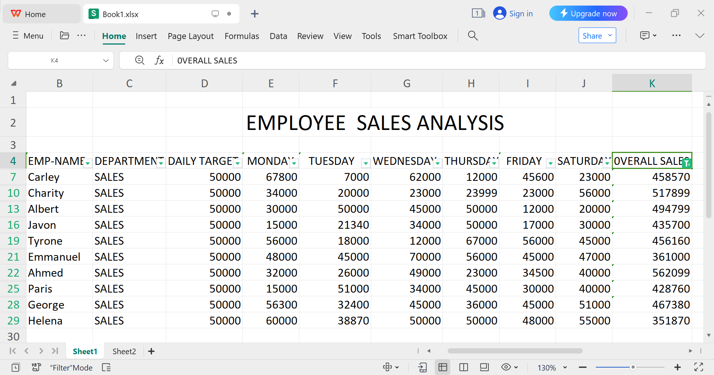

THE "WOW" IN OUR SOLUTION This analysis helps to figure out those employees who have completed the target with help of IFS formula.
3/21/2024 Annual Review
9

Slide 10
MODELLING
Data set: Kaggle , employee dataset.
Data cleaning: missing values, irrelevant.
Formula: Performance calculation , low, med , high.
Pivot table: summary , business unit, employee ID , name , department , daily sales, and overall sales.
Filter: shows those who achieved target.
chart: report.
10

Slide 11
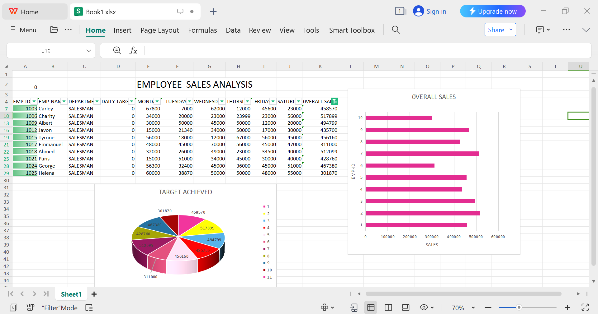
RESULTS
11

Slide 12
Conclusion The Employee Sales Analysis project reveals valuable insights into the sales performance of the employees. This helps to identifies top-performing employees and the factors contributing their success , including effective sales strategies , in-depth knowledge. The analysis also covers trends and patterns in the sales data, highlighting opportunities to optimize sales performance through targeted training and development programs. By addressing areas for improvement and leveraging these insights , we can increase revenue growth , enhance employee engagement and retention and inform data-driven decision making

